Slide 1
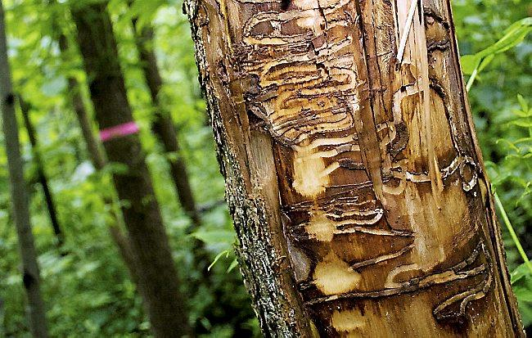
Emerald Ash Borer
By: Jacob Leonard, Jennifer Phan, and Brian Khin

Slide 2
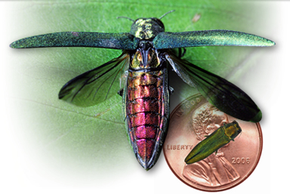

Slide 3
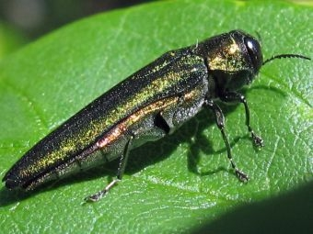
Background
Agrilus Planipennis
invasive green beetle native to Asia and Eastern Russia
accidently brought into the US
First discovered in North America in Michigan in 2002

Slide 4
Ecological and Economic Impact
can virtually eliminate all N. American trees
Most costly biological invasion from a forest insect
Responses to impact include treatment, removal, and replacement of more than 17 million ash trees estimated to cost $10.7 billion

Slide 5
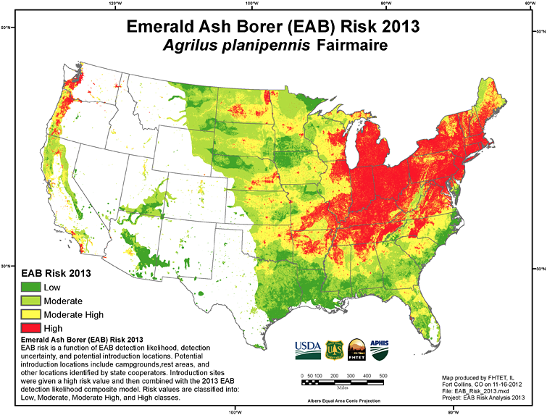

Slide 6
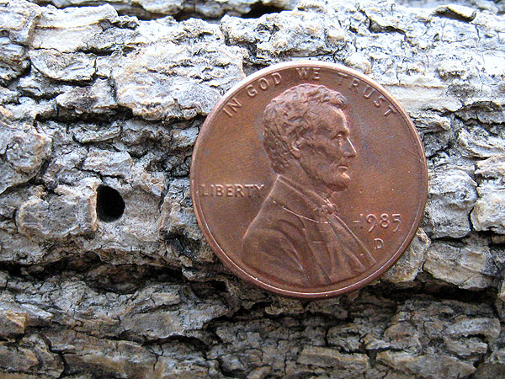
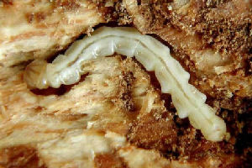
EAB impact on ash trees
only living trees are colonized
adult EAB feed on foliage, impact is insignificant
larva tunnels under the bark and feeds on phloem and xylem tissue
distinctive small D-shaped exit hole in the trunk is a sign of infestation
resulting in tree death typically within 2-4 yrs of initial infestation

Slide 7
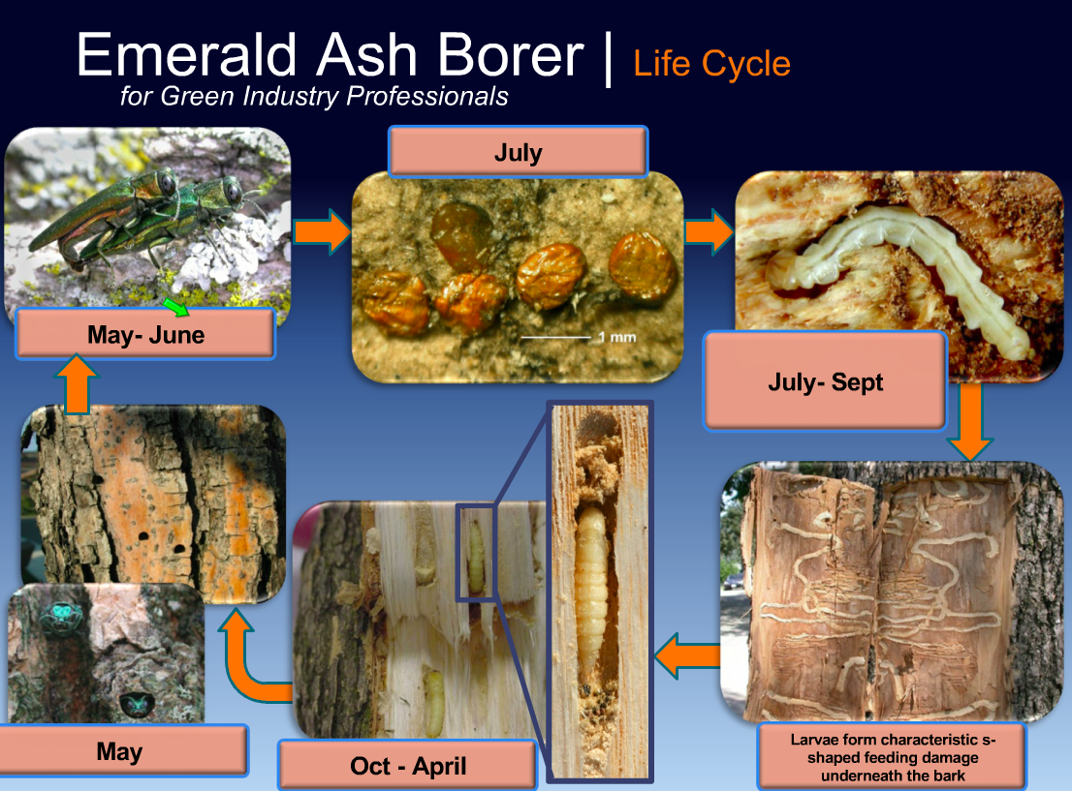
Life Cycle of the EAB

Slide 8
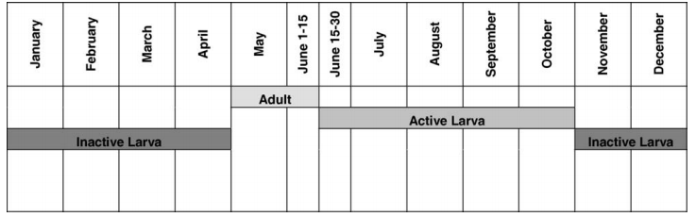
Life Cycle Model
Adult→ Adult Emigration→ Eggs→ Active Larva-->Inactive Larva-->Adult

Slide 9
Model Assumptions
Egg laying in asexual population
Female egg laying rate = 40-70 eggs, mean at 55 eggs with 5 SD.
Asexual halved mean to 27.5 and SD of 2.5
Bugs spread evenly to surrounding trees based on how many of them are alive
when a tree hits its carrying capacity for larva, it dies and so do the larva

Slide 10
Life Cycle Assumptions
The survival rate of active larvae is 60%
The survival rate of inactive larvae during the winter is 99.5% per week for 24 weeks

Slide 11
Model Variables
m: number of timesteps (yrs)
n: Forest area is defined as a square: nxn matrix
AB(i,j,m): Number of adults at beginning of a life cycle and emigrate from tree to tree
Origin of initial infestation is chosen at random in the forest
AD(i,j,m): Number of adults that end up at a destination tree and lay eggs
AL(i,j,m): Number of active larva on a tree AL=zeros(n,n,m)
IAL(i,j,m): Number of inactive larva
TreeStatus(i,j,m): Indicates whether a tree is alive (1) or dead (0)
Cost (10,1000): Cost of treatment for each percentage of trees treated
range of the percentage of trees treated = [.05,.1,.15,.2,.25,.3,.35,.4,.45,.5]
(10 different percentages, 1000 run throughs each)
MeanCost (1,10) = mean(Cost(i,:))
TreeDeathTotal (10,1000) = Total number of tree deaths resulting from each percentage of treatment, at 1000 runs each

Slide 12
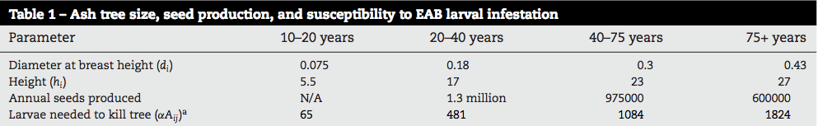
Forest Model
Forest is made up of trees from four age groups: 10-20yrs, 20-40yrs, 40-75yrs, 75+yrs
trees are evenly and randomly distributed throughout the forest
carrying capacity of the number of larvae a tree can hold until its death is determined by tree age

Slide 13

Video Representation of Spread

Slide 14
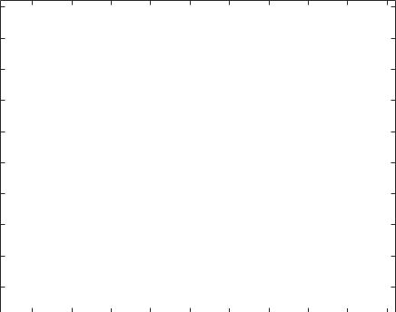
Video Representation of Tree Death

Slide 15
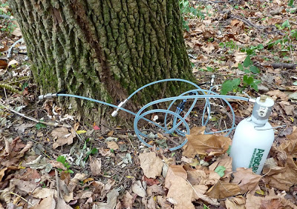
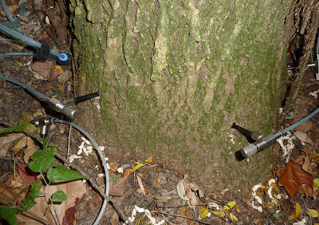
Treatment
systemic Insecticide Emamectin Benzoate
Effectiveness: 99% fewer larvae than untreated trees
treatment effective for 2 years
injection transported through the trunk and into the canopy by hiring a forest surveyor
earliest the insecticide could be applied would be the spring following the initial infestation or 4 years after the initial introduction
only option that retains ash trees, including the valuable landscape ash in the projected area

Slide 16
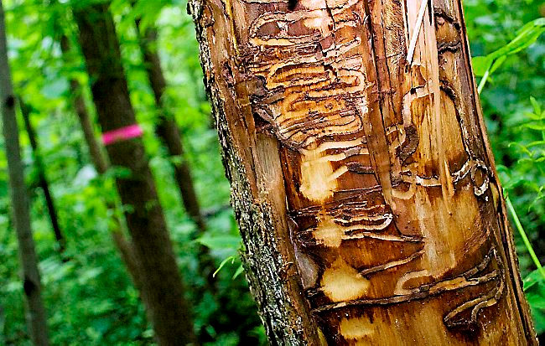
Treatment Model Approach
model was simulated to equilibrium, 1000 times
recorded the number of trees that died each time
Tree Deaths (3rd time step): mean=37.45
Tree Deaths (4th time step): mean= 35.41
Tree Deaths (5th time step): mean = 22.79
Tree Deaths (6th time step): mean = 18.89
treatment effectiveness was measured by number of tree deaths
forest surveyor found the infected forest perimeter
treatment started at 4th year
selection of treated trees were randomly selected after the infected area perimeter became known
“Randomly selecting trees for treatment, for example, ultimately protected more trees over the 10-year period than targeting trees within a 2-block radius from the origin of the infestation for treatment.”
Range of 5%- 50% of proportion of trees to treat was tested to examine what resulted in the least trees deaths
Minimizing the cost to treat the number of trees was also considered to determine the optimal percentage of trees to treat

Slide 17
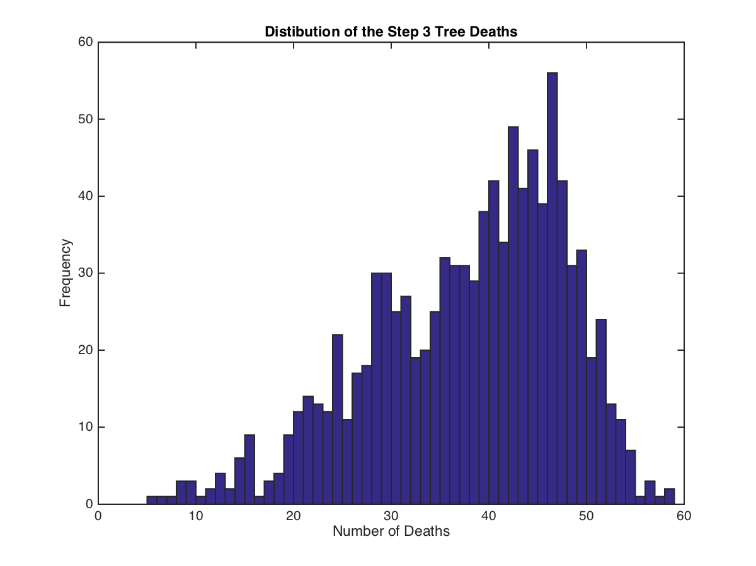
The number of trees that die between timestep 3 and 4 has a mean = 37, but a distribution skewed to the right

Slide 18
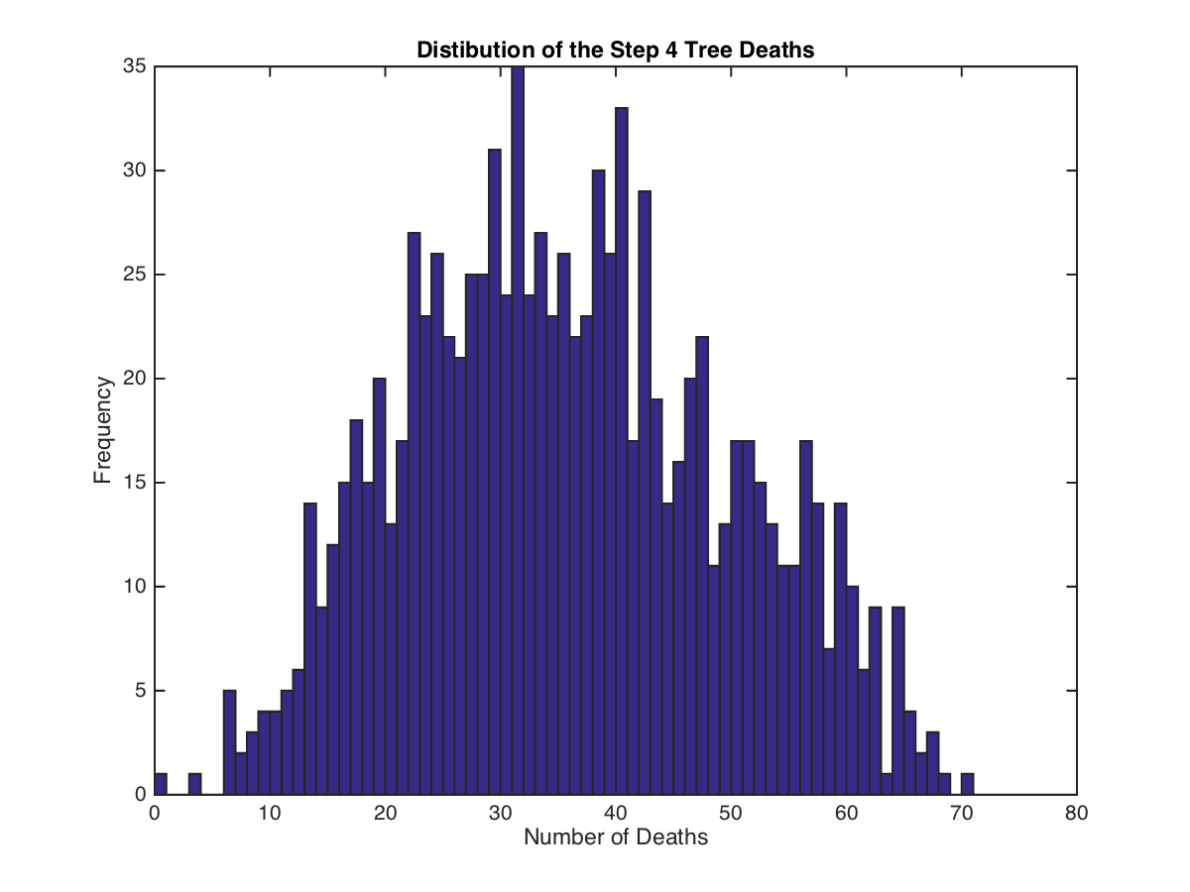
The number of trees that die between timestep 4 and 5 has a mean = 35, and a fairly normal distribution

Slide 19
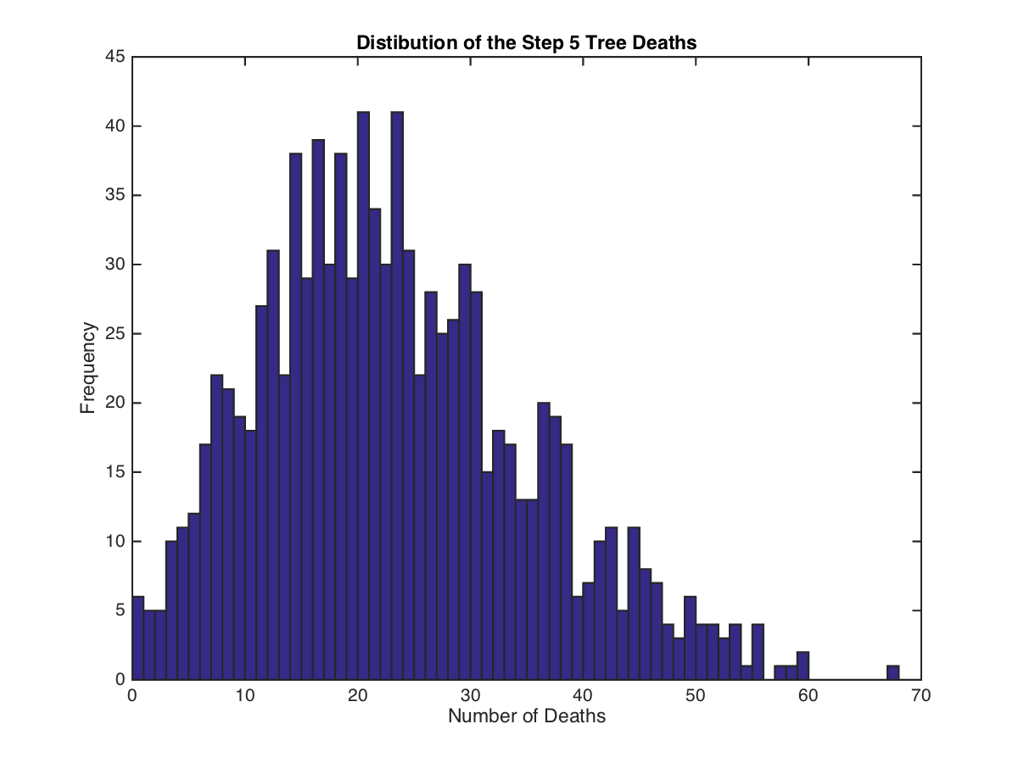
The number of trees that die between timestep 5 and 6 has a mean = 22, but a distribution skewed to the left

Slide 20
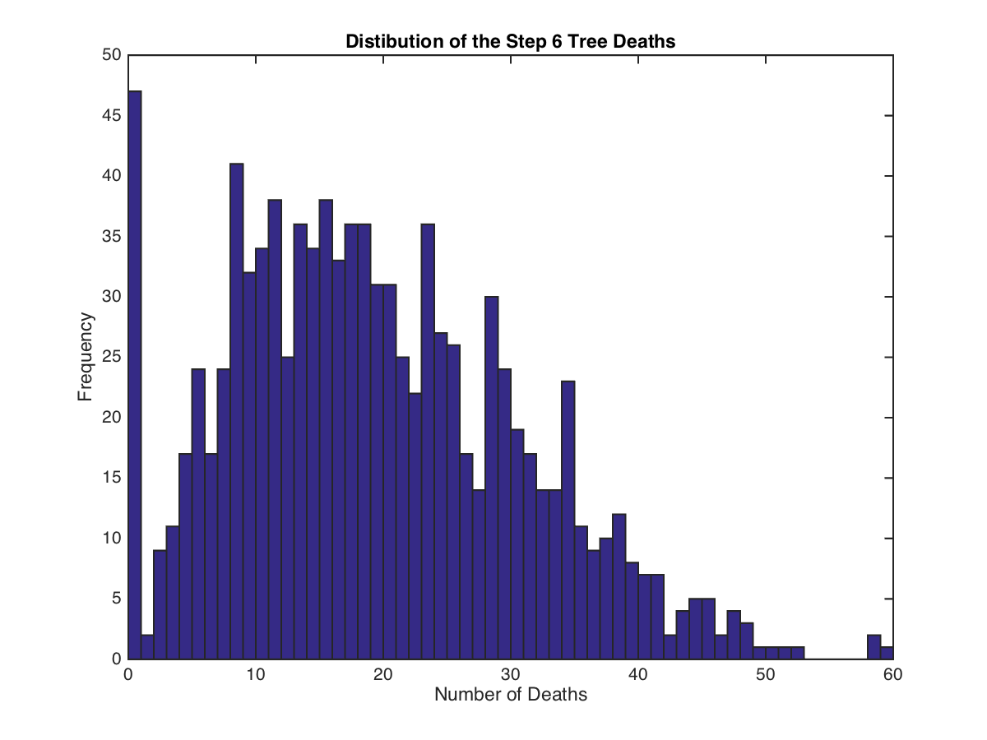
The number of trees that die between timestep 6 and 7 has a mean = 18, and a more left-wise skewed distribution

Slide 21
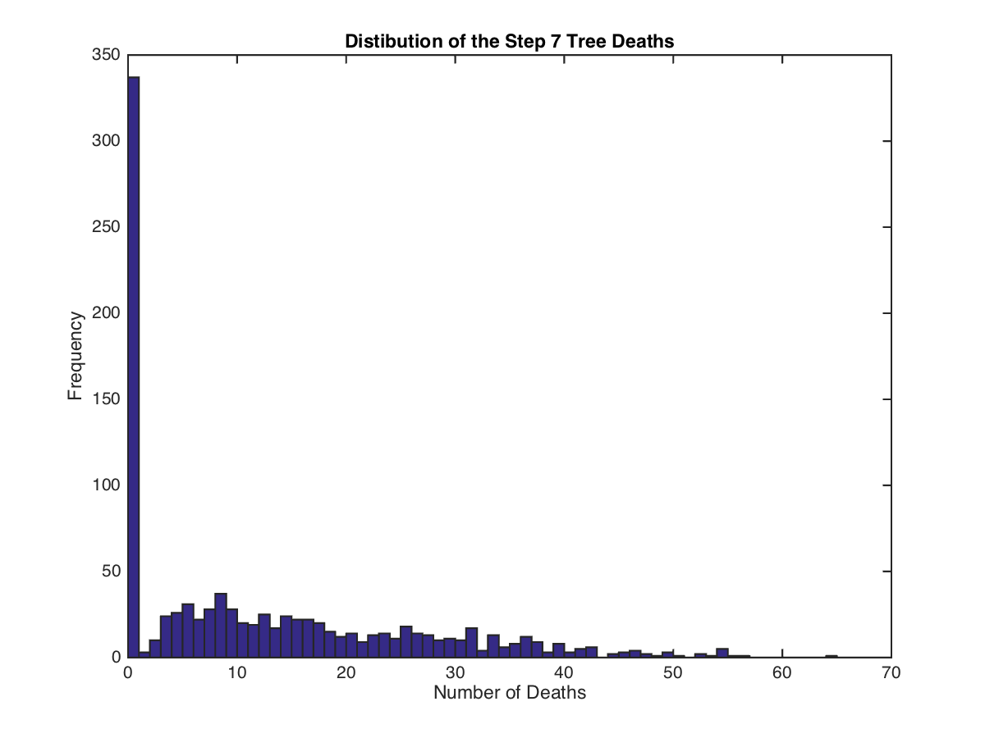
The number of tree deaths between timestep 7 and 8 is extremely left skewed due to the scenarios where the bugs over consume their food supply

Slide 22
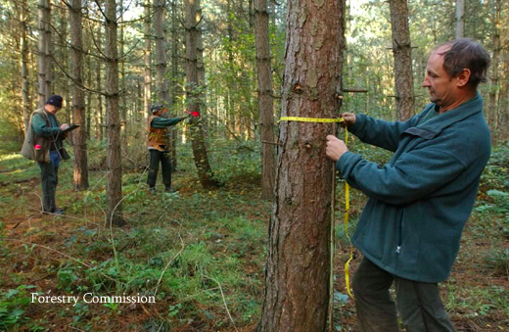
Treatment Cost Estimates
Emamectin Benzoate approximately costs $16 per inch DBH
Cost to treat tree according to age and DBH:
Estimated Cost of Forest Surveyor:
surveyor inspects 10 trees hour, 49 by 49 project area -->2401 trees
pay rate: $13.50/hour + bonus → $5000 per inspection of the full project area
10-20 years | 20-40 years | 40-75 years | 75+ years
6 in | 14 in | 24 in | 34 in
$96 | $224 | $384 | $544

Slide 23
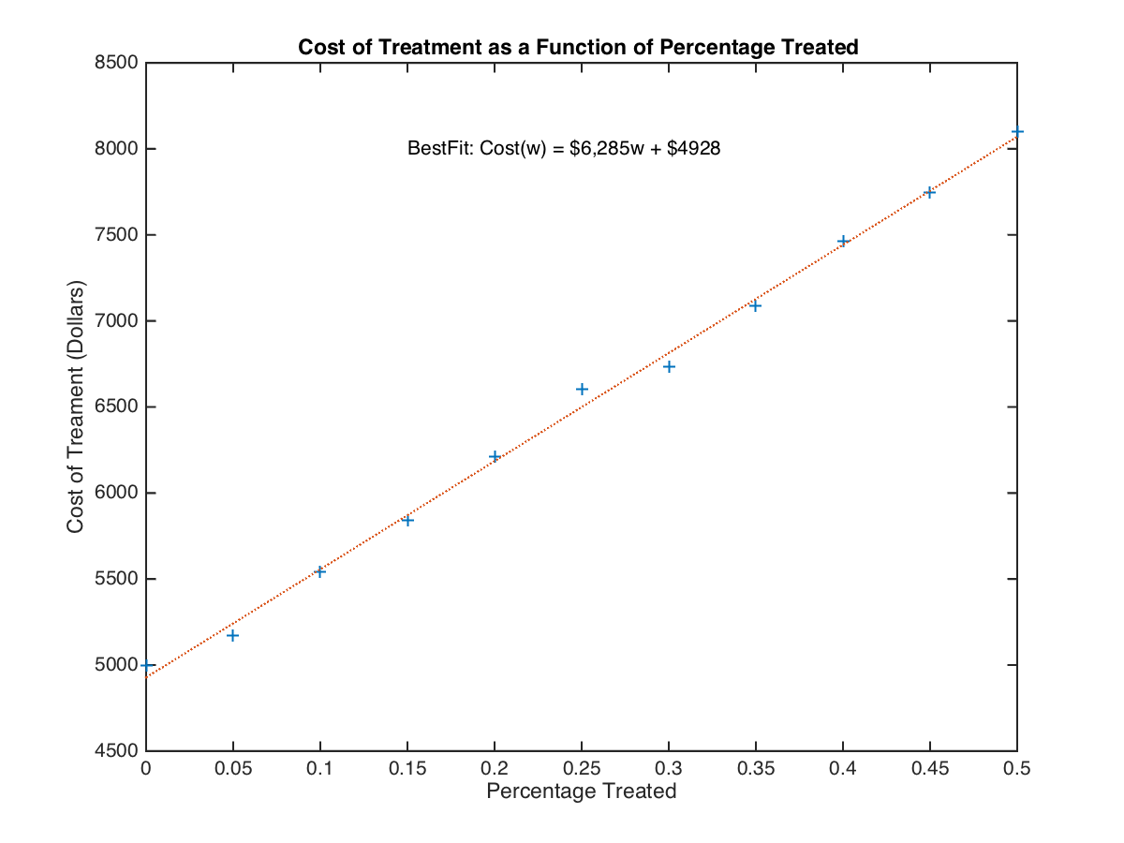

Slide 24
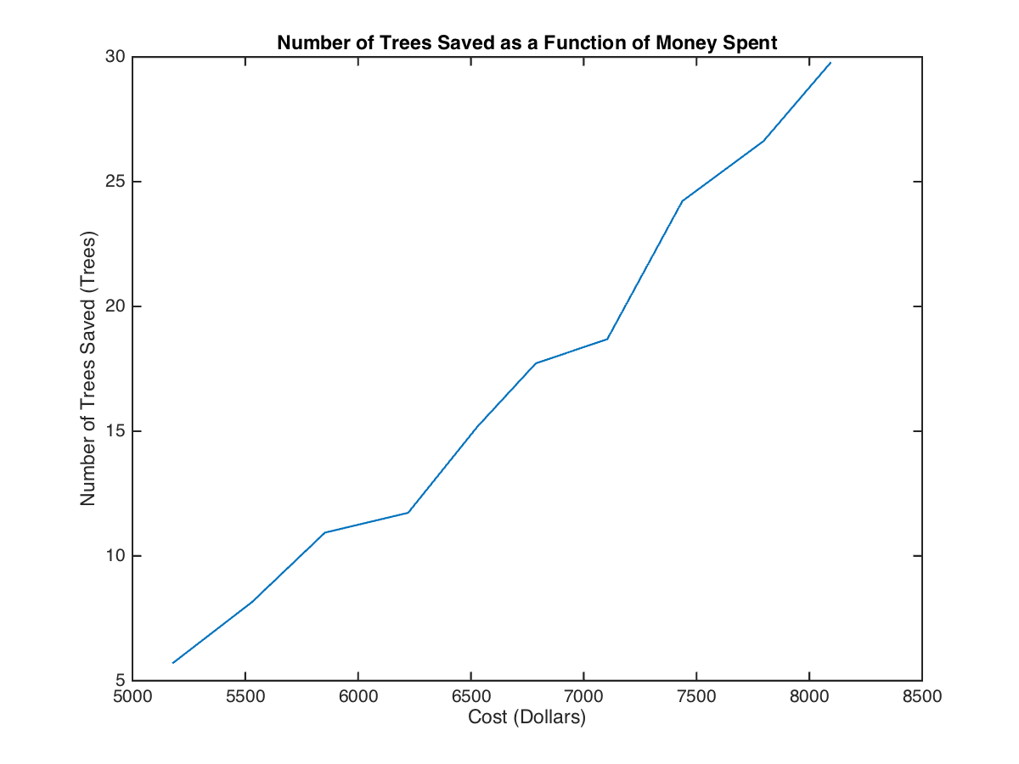
The number of trees saved based on Cost changes in an overall linear pattern, so curve fitting was not the best option to determine the optimal percentage of trees to inject with insecticide
Instead, the largest slope differential was calculated to determine where the largest gain was achieved

Slide 25
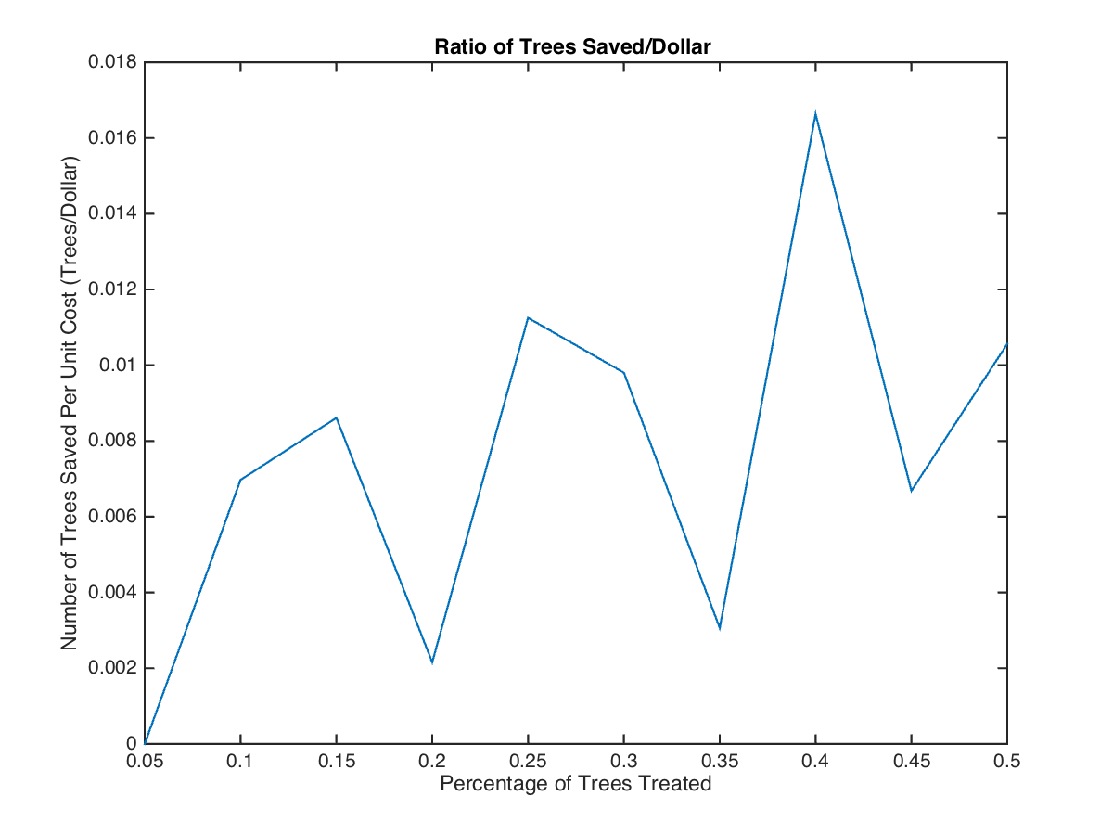
It can be seen that the largest gain in Trees saved per unit cost occurs at w = 40%, or between 35% and 40%

Slide 26
Model With Treatment Video
With one treatment cycle, and a 40% treatment rate, of randomly selected trees, we were able to achieve a 20% reduction in tree deaths, at a cost of $7,442 => $3.10/tree
With about 5ft between trees, that’s 1742 trees/acre => $5,399/acre

